Slide 1
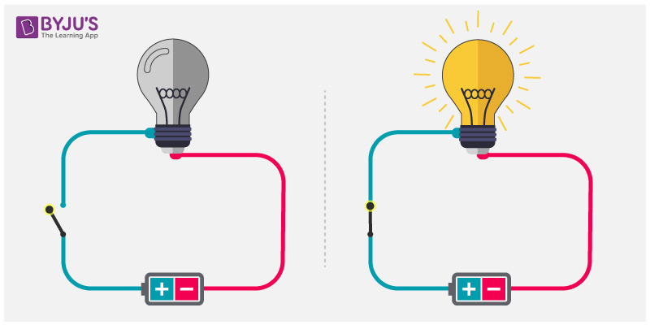
Daily review
CFU 1
List the 3 essential components of all electric circuits
Electric Circuits
A pathway travelled by electrical energy
Circuits can vary from very complex (e.g. in your phone) to very simple (e.g. in a torch)
However all circuits have 3 essential components
A power source
A pathway
A load
We typically also put a switch into our
circuits, to allow us to control when they
are open and closed
CFU 2
Describe a switch, and explain why it is useful in a circuit

Slide 2
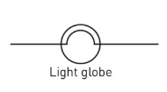
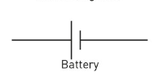
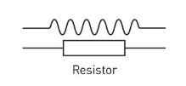

Daily review
Circuit Diagrams
Using your understanding of circuit diagram symbols, identify the following components of electrical circuits.
1
4
2
3

Slide 3
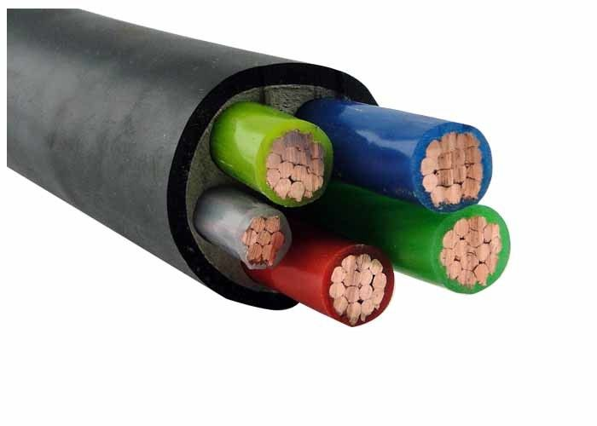
Daily review
CFU 1
Differentiate between a conductor and an insulator, giving one example of each
Conductors
A material that allows the flow of charge.
Insulators
A material that does not allow the flow of charge.
CFU 2
Look at the electrical cable in the picture. Describe the structure of the cable, mentioning reasons for locations of conductors and insualtors

Slide 4
Series and Parallel Circuits Year 9 Physics

Slide 5

Learning Objectives
CFU
What are we going to learn today?
Differentiate between series and parallel circuits
Identify parallel and series circuits on circuit diagrams
Activate Prior Knowledge
Think about your house, how are your lights controlled?
Are all the lights controlled by one switch?
What happens when a globe blows?

Slide 6
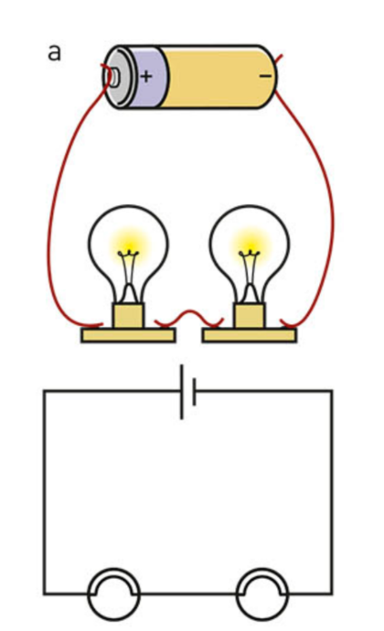
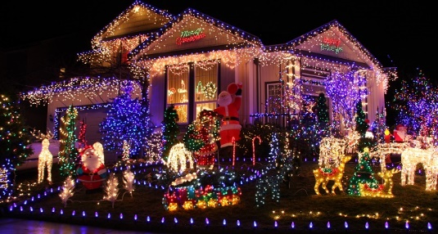
Concept Development
CFU 1
In picture a) if the right globe blows, describe what would happen to the other globe.
Series Circuit
Two or more electrical components connected side by side on the same conducting pathway.
A break in any part of the circuit effects all components in the circuit.
Christmas lights are connected in series in order to reduce the number of cables needed.
CFU 2
Describe a conducting pathway.
CFU 3
Think-pair-share: can you think of any other times series circuits may be used?
Vocabulary
Conducting pathway: path which allows charge to flow from one terminal of a battery to another

Slide 7
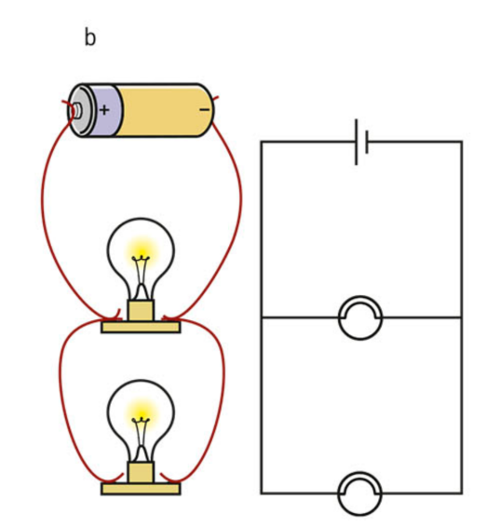

Concept Development
CFU 1
In picture b) if the bottom globe blows describe what would happen to the other globe?
Parallel Circuit
Two or more electrical components connected on different conducting pathways on the same circuit.
A break in one conducting pathway will still allow charge to flow through any other pathways.
Household lights and appliance are connected in parallel.
CFU 2
Explain why household lights are connected in parallel.
CFU 3
Think-pair-share: can you think of any other times parallel circuits may be used?
Vocabulary
Conducting pathway: path which allows charge to flow from one terminal of a battery to another

Slide 8
Skill Development
CFU 1
Identify components in circuit
Drawing circuits
Identify the electrical components in the circuit. Start from the power source, place the components in the correct order (considering which are in parallel or series). Connect each component with connecting wires
CFU 2
Series or parallel?
CFU 3
Draw components in order
Draw a circuit showing 2 globes and a switch in series with a battery.
CFU 4
Connect with wires
Globe
Globe
Switch
battery
Series
CFU 5
Does this switch control one globe or both globes?

Slide 9
Skill Development
CFU 1
Identify components in circuit
Drawing circuits
Identify the electrical components in the circuit. Start from the power source, place the components in the correct order (considering which are in parallel or series). Connect each component with connecting wires
CFU 2
Series or parallel?
CFU 3
Draw components in order
Draw a circuit showing a battery, 2 globes in parallel, and a switch that controls both globes.
CFU 4
Connect with wires
Globe
Globe
Switch
battery
Parallel
Switch controls BOTH globes
CFU 5
Describe the effect on the circuit if the bottom globe blows.

Slide 10
Skill Development
CFU 1
Identify components in circuit
Drawing circuits
Identify the electrical components in the circuit. Start from the power source, place the components in the correct order (considering which are in parallel or series). Connect each component with connecting wires
CFU 2
Series or parallel?
CFU 3
Draw components in order
Draw a circuit showing a battery power a circuit that contains 2 globes in parallel, with a switch controlling each globe.
CFU 4
Connect with wires
Globe
Globe
Switch
Switch
battery
CFU 5
Where might you find a circuit like this?
Parallel
Switch controls EACH globes

Slide 11
Skill Development
CFU 1
Identify components in circuit
Drawing circuits
Identify the electrical components in the circuit. Start from the power source, place the components in the correct order (considering which are in parallel or series). Connect each component with connecting wires
CFU 2
Series or parallel?
CFU 3
Draw components in order
Draw a circuit showing a battery in series with a switch, an ammeter, and a globe, with a resistor in parallel to the globe.
CFU 4
Connect with wires

Slide 12

Skill Closure
Explain how a parallel circuit is different to a series circuit.
Skill Closure
Using your understanding of parallel and series circuits, explain why the lights in a house are wired in parallel, rather than in series.
Skill Closure
A string of fairy lights can have hundreds, or even thousands of globes. Explain why they are usually wired in series, as opposed to in parallel.

Slide 13
Independent Practice
Complete the circuit diagram practice worksheet.
Remember:
Use a ruler and pencil
Ensure that your drawing is large enough to see everything clearly
Neatness is important

